Slide 1
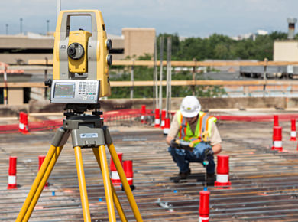
Setting up the total station on a point measurements
A total station should be positioned on a point and leveled properly to achieve better results. You need to spend time on this process. It may take more time than you think.

Slide 2
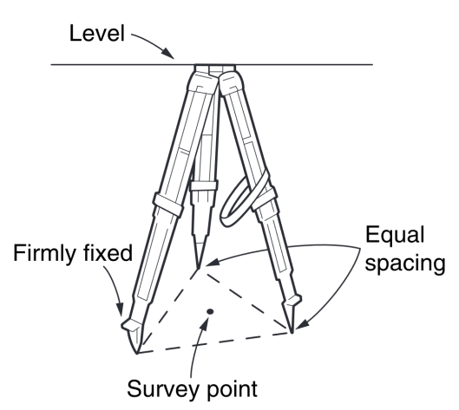
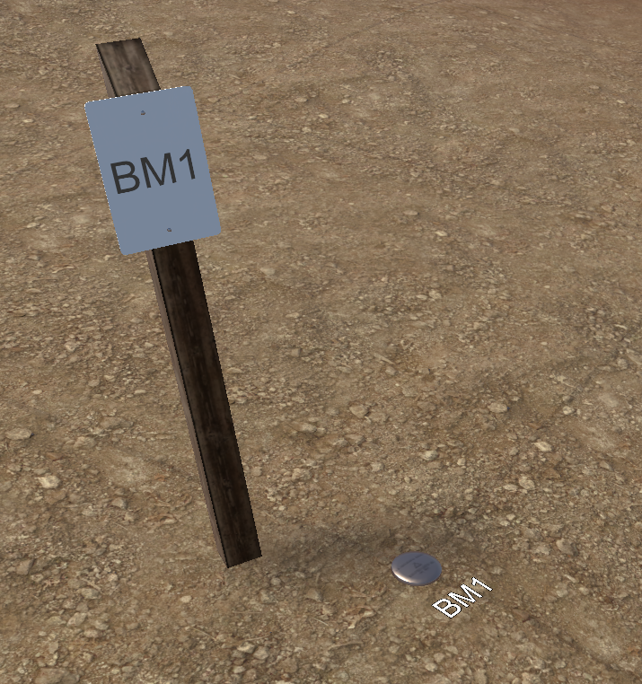
Step 1: Tripod set up
Place tripod over survey point
Tripod legs should be equally spaced
Make sure the tripod head is level
Tripod head should be directly over the survey point
Tripod should be firmly pressed to the ground.
Survey point

Slide 3
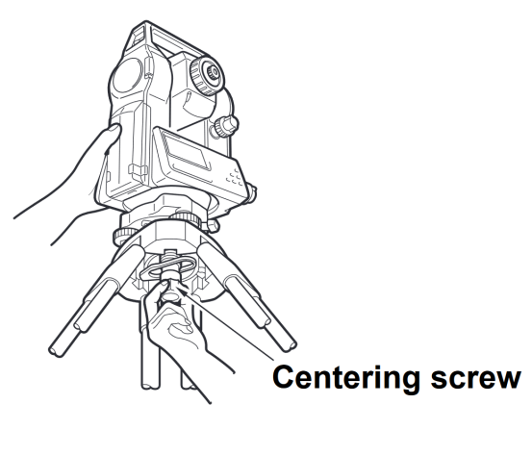
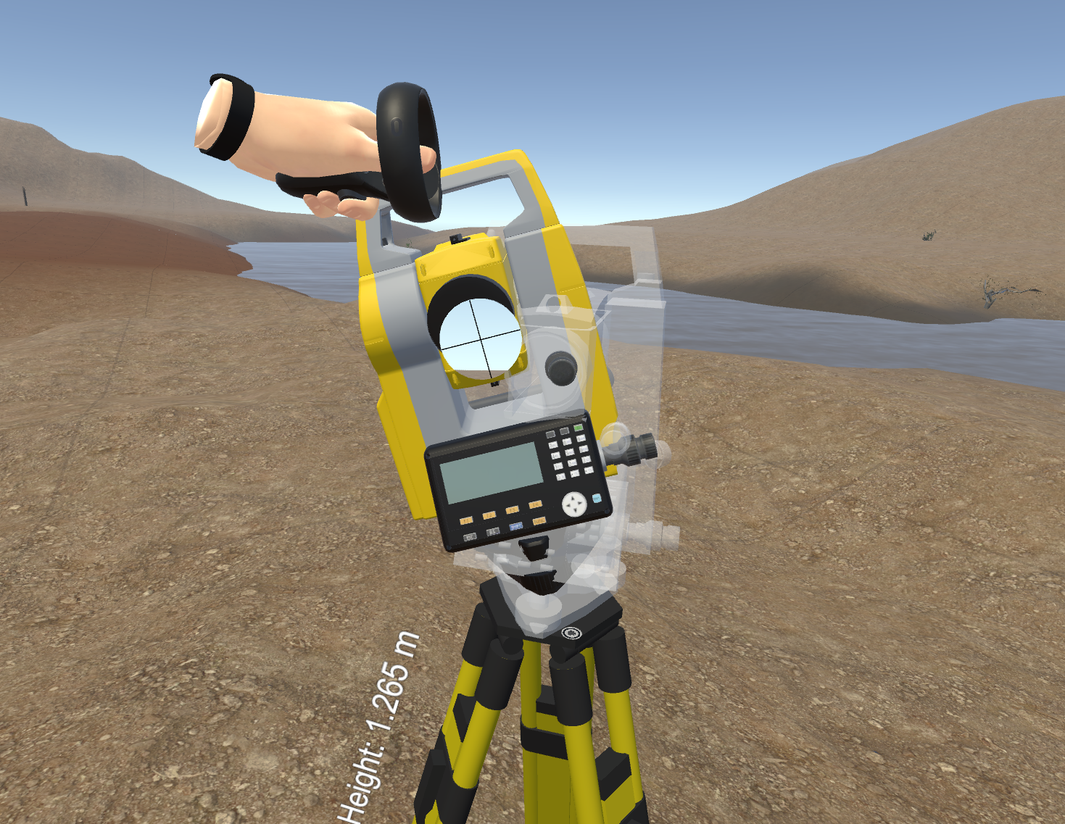
Step 2: Mount Instrument on Tripod
Grab Instrument by the handle
Place Instrument on Tripod
In the real world:
Secure with centering screw while bracing the instrument with the other hand
Insert battery in instrument before leveling

Slide 4
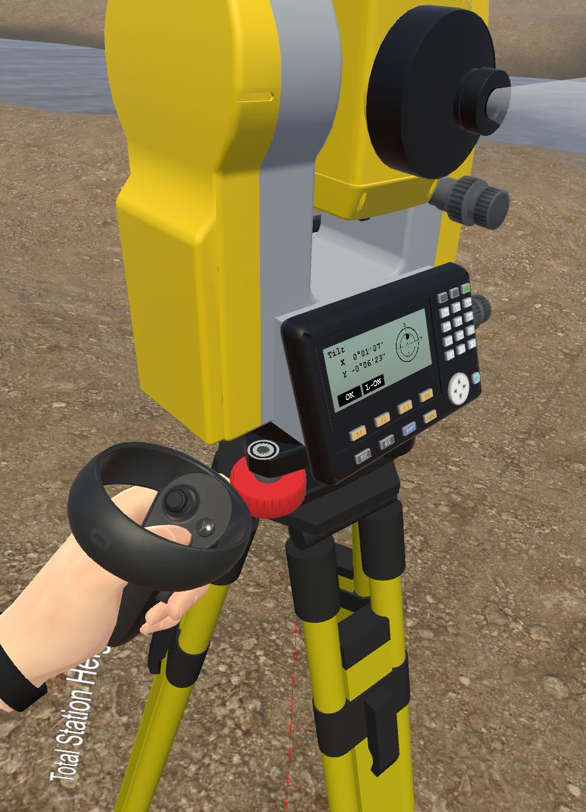
Step 3: Focus instrument on Survey
Point
Turn on the instrument by pressing the “on” button (you should hear an audible beep)
Turn the laser plummet on (L-ON button)
Adjust the leveling foot screws to center the laser on the survey point
Center the bubble in the circular level by adjusting the tripod legs
Bubble level
Foot screws
Laser plummet
laser

Slide 5
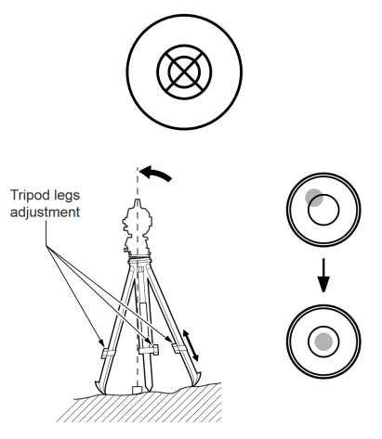
Step 4: Leveling the Instrument
Turn the instrument until the plate level is parallel to 2 of the leveling foot screws
Center the bubble using the leveling screws- the bubble moves toward the screw that is turned clockwise
Rotate the instrument 90 degrees and level using the 3rd leveling screw
In the real world:
You would need to loosen the clamps to rotate the instrument

Slide 6
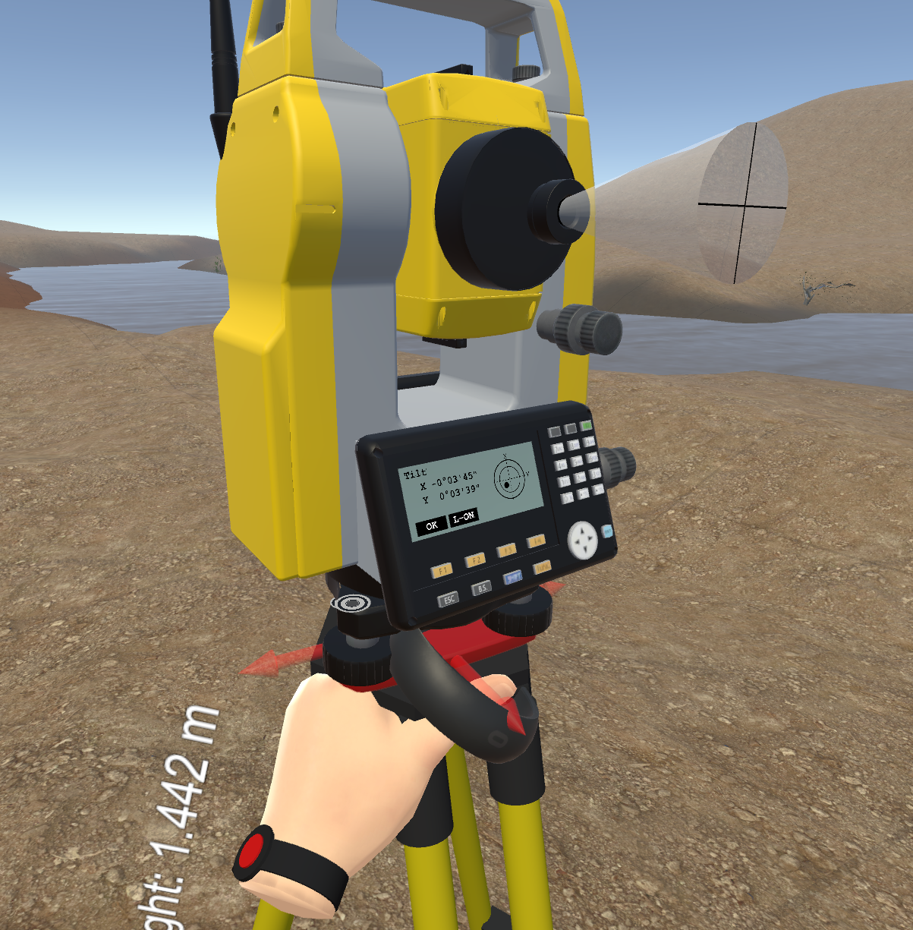
Step 4: Leveling the Instrument
Observe the survey point with the laser and center the point by sliding the entire instrument
Check to make sure the plate level bubble is level in several directions
In the real world:
You would need to loosen the centering screw to shift the total station. Make sure to retighten the screw.

Slide 7
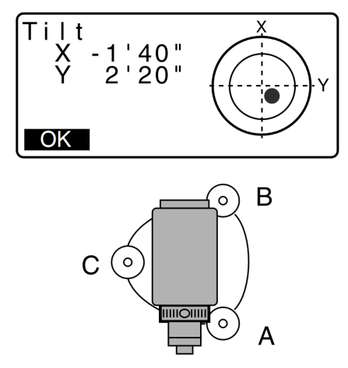
Step 5: Leveling the electronic bubble
Adjust the foot level screws to exactly center the electronic “bubble”
Rotate the instrument 90 degrees and repeat
Press OK when you are done
END OF SLIDESHOW

